Slide 1
1862: Antietam and Emancipation
The Civil War Curriculum

Slide 2
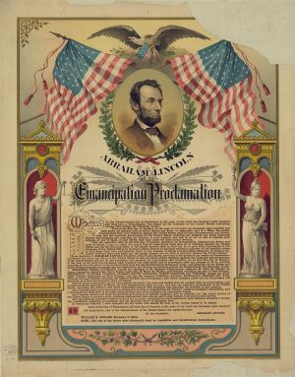

Antietam & Emancipation
Activity
Pick up a post-it note and answer the
following question:
What does “emancipation” mean?

Slide 3
Emancipation:
the fact or process of being set free from legal, social, or political restrictions; liberation

Slide 4
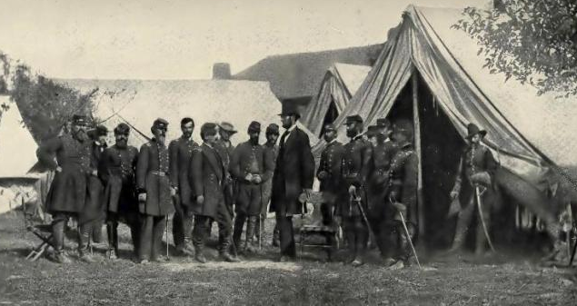
The War So Far
Activity
Read through the Timeline.
Notes:
The war had not been going well for the Union armies around Washington, D.C.
In the east, the Union had lost every major battle in which it had fought in 1861 and 1862. In the west,
The Union won major battle after major battle, but with the majority of the population being situated on the
East Coast, most Americans focused on the east rather than the west.

Slide 5
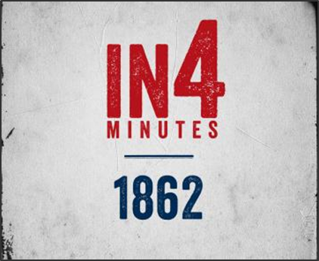

The War So Far
Activity
Watch 1862 In4 Video until 3 min 34 seconds.
How did the Union feel as the summer of 1862 came to an end?
Why might public approval of a war be so important?
Notes:
https://www.battlefields.org/learn/videos/civil-war-1862

Slide 6
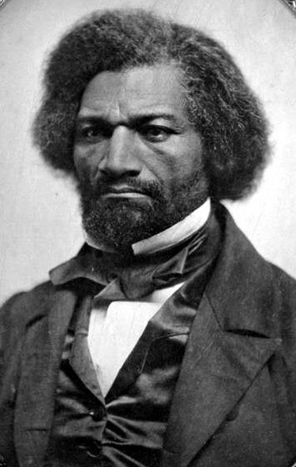
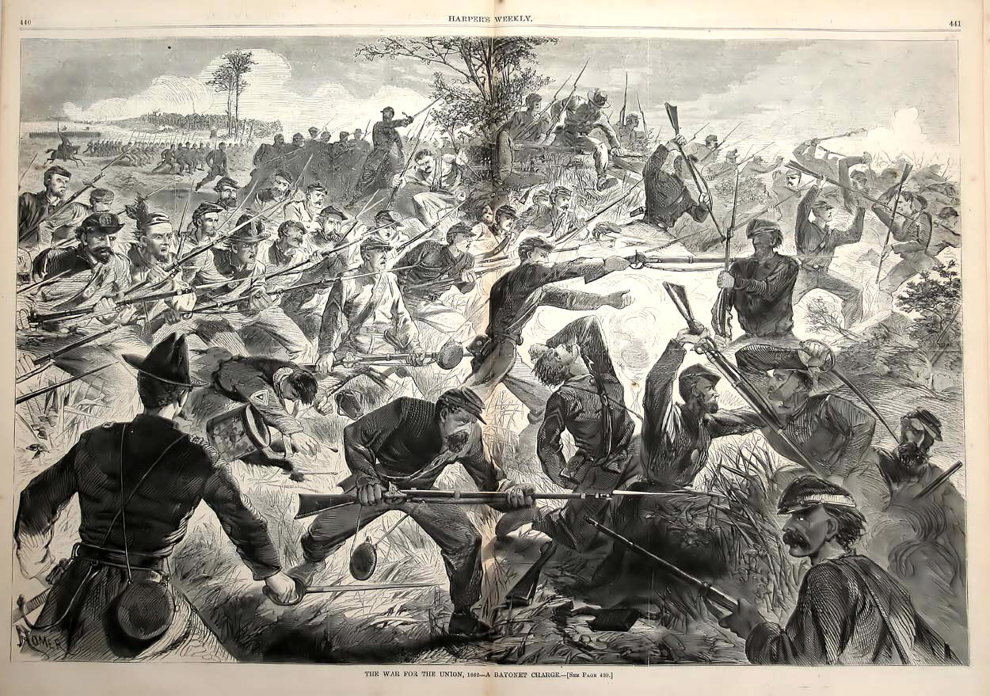
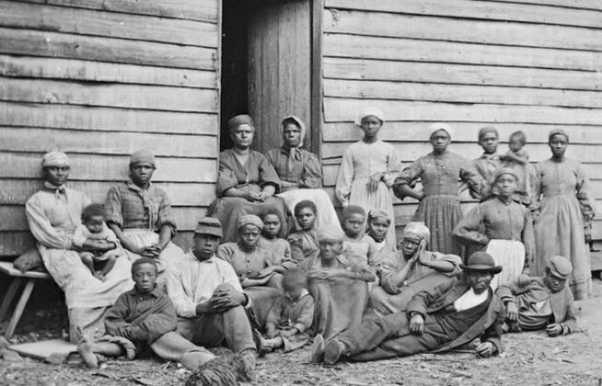
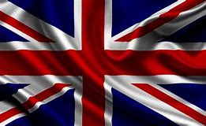
Pressure Builds
By the summer of 1862:
  Lincoln is faced with increasing pressure from abolitionists seeking emancipation as part of the war effort.
  The risk of foreign involvement grows (Great Britain and France could recognize and help the Confederacy).
  Large numbers of slaves are leaving their owners and entering Union army camps as refugees.
  Loss of battles leads to less war support from US citizens.

Slide 7
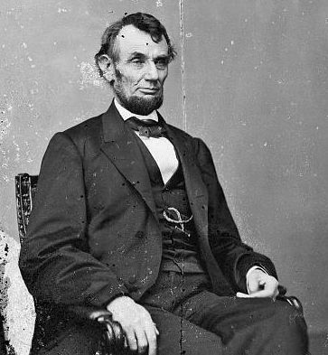
As the war began and states seceded, President Abraham Lincoln called for volunteers to stop the secession and save the Union.
At this point, it is clear that something major needed to be done to change the course of the war.

Slide 8
Union Victory
On July 22, 1862, Lincoln presents the Preliminary Emancipation Proclamation to his cabinet.
Secretary of State, William Seward suggests that a Union victory should be achieved before issuing the proclamation.
“It may be viewed as the last measure of an exhausted government, a cry for help…. Postpone its issue, until you can give it to the country supported by military success, instead of issuing it, as would be the case now, upon the greatest disasters of the war!”
– Secretary of State, William Seward.
Notes:
Have students look at their timeline and see where the war is militarily in mid-July.
Seward’s quote comes from Six Months in the White House by Francis Bicknell Carpenter, Hurd and Houghton, 1872. The “greatest disasters of the war” is in reference to McClellan’s failed Peninsula campaign.

Slide 9
The first reading of the Emancipation Proclamation before the cabinet. Painted by F.B. Carpenter

Slide 10
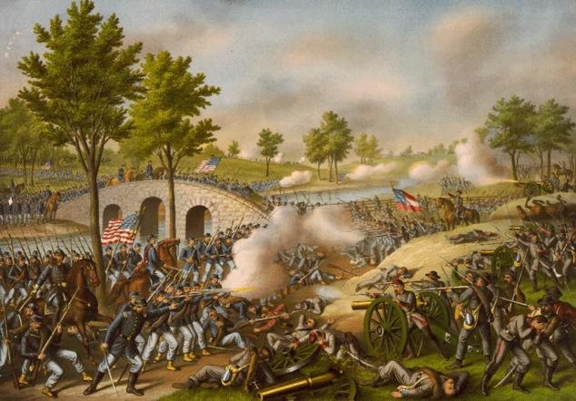
Antietam
September 17, 1862

Slide 11
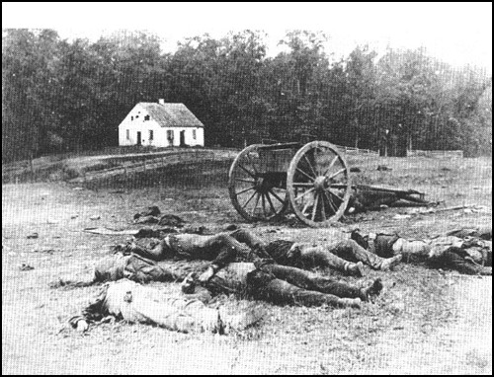
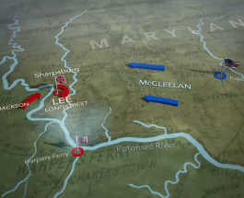
The Battle of Antietam
Activity
As a group read the Battle of Antietam Summary.
And/or
Watch the Antietam Animated Map
Notes:
https://www.battlefields.org/learn/maps/antietam-animated-map

Slide 12
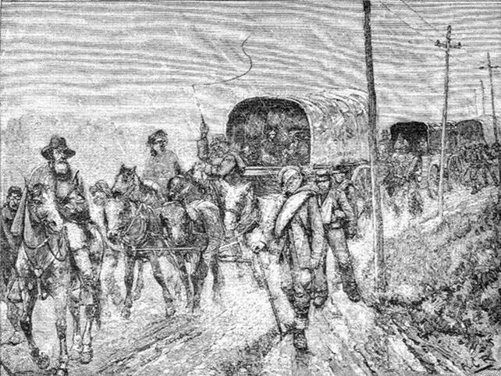
The Battle of Antietam
Result: The Confederate Army retreats from Maryland, back into Virginia. This allows the Union to claim a victory.
Abraham Lincoln now has the victory he desired to issue the Emancipation Proclamation.

Slide 13
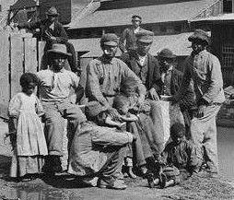
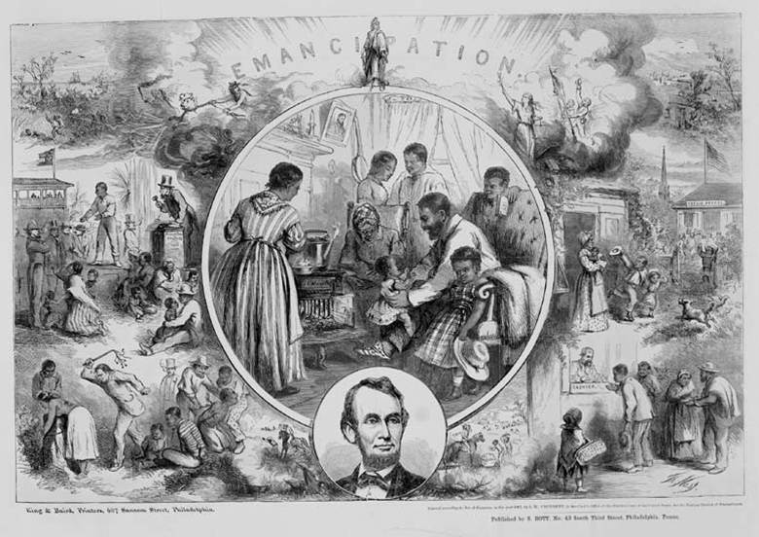
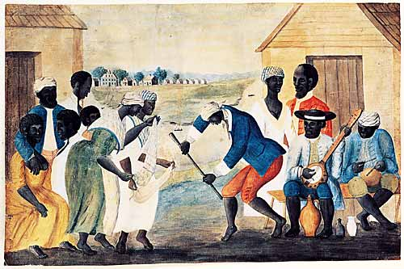
Emancipation
Activity
Read through the Emancipation Proclamation
Notes:
Segment of the Emancipation Proclamation can be found on the next page

Slide 14
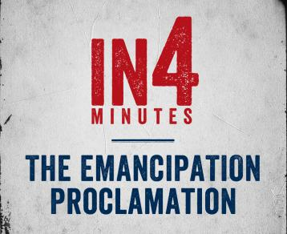
The Emancipation Proclamation
Activity
Watch the Emancipation Proclamation In4 video.
Notes:
https://www.battlefields.org/learn/videos/emancipation-proclamation

Slide 15
Emancipation
With the Emancipation Proclamation, the war is still about preserving the Union and freeing the slaves is a necessary war measure.

Slide 16
Let’s look again at the issues Lincoln was facing before the Emancipation Proclamation…

Slide 17
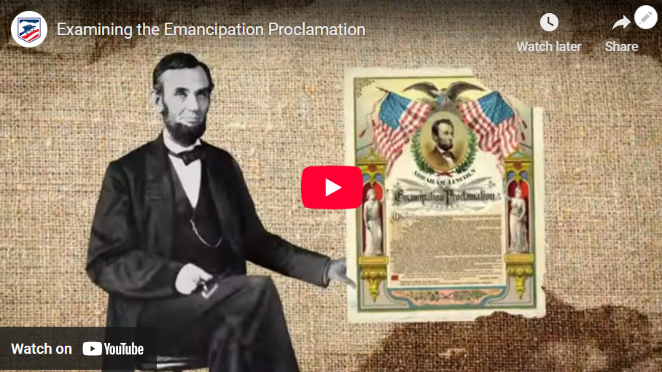
Examining the Proclamation
Activity
Watch the Emancipation Proclamation Exposed video.
Notes:
Emancipation Proclamation Exposed | American Battlefield Trust

Slide 18
    Issue: Lincoln is faced with increasing pressure from abolitionists seeking emancipation as part of the war effort.
Abolitionists see the Emancipation Proclamation as a step in the right direction for the emancipation of all slaves. They will continue their fight for the end of slavery throughout the entire country.

Slide 19

Issue: The risk of foreign involvement.
By winning at Antietam, the Union showed its ability to win in the Eastern Theater of the Civil War. Additionally, most Europeans did not support slavery; therefore, now that the war included freeing the slaves, they decide not to get involved.

Slide 20
    Issue: Large numbers of slaves are leaving their owners and entering Union army camps as refugees.
    Caring for refugees is still difficult, but before there were questions on what to do with the refugees. With the Emancipation Proclamation it is known to all commanders that “the military and naval authorities thereof, will recognize and maintain the freedom of said persons.”

Slide 21
    Issue: Loss of battles leads to less war support from US citizens.
With the success at Antietam and Robert E. Lee’s retreat, support for the war has increased.

Slide 22
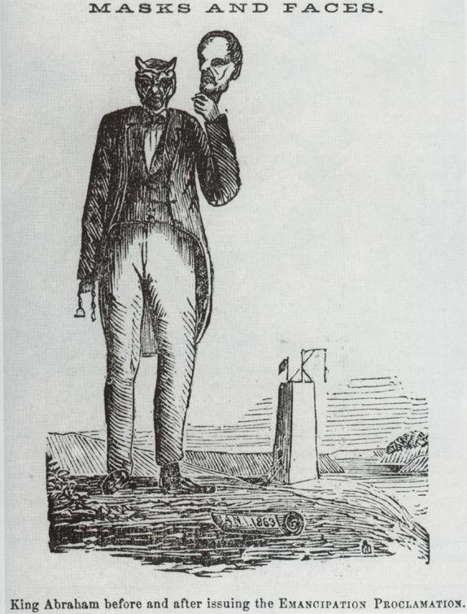
Reactions to the Proclamation
“We are all liberated by this proclamation. Everybody is liberated. The white man is liberated, the black man is liberated, the brave men now fighting the battles of their country against rebels and traitors are now liberated… I congratulate you upon this amazing change—the amazing approximation toward the sacred truth of human liberty.“ – Frederick Douglass
“And whereas the President of the United States has by public and official declaration signified not only his approval of the effort to excite servile war within the Confederacy but his intention to give aid and encouragement thereto if these independent States shall continue to refuse submission to a foreign power after the 1st day of January next, and has thus made known that all appeals to the laws of nations, the dictates of reason and the instincts of humanity would be addressed in vain to our enemies, and that they can be deterred from the commission of these crimes only by the terms of just retribution.” – Jefferson Davis
Notes:
Cartoon – "King Abraham" Before and After Issuing the Emancipation Proclamation | American Battlefield Trust
Frederick Douglass – Formerly enslaved person, an advocate for abolition and civil rights – Frederick Douglass | American Battlefield Trust
Jefferson Davis – Political Leader, became the President of the Confederacy – Jefferson Davis | American Battlefield Trust

Slide 23
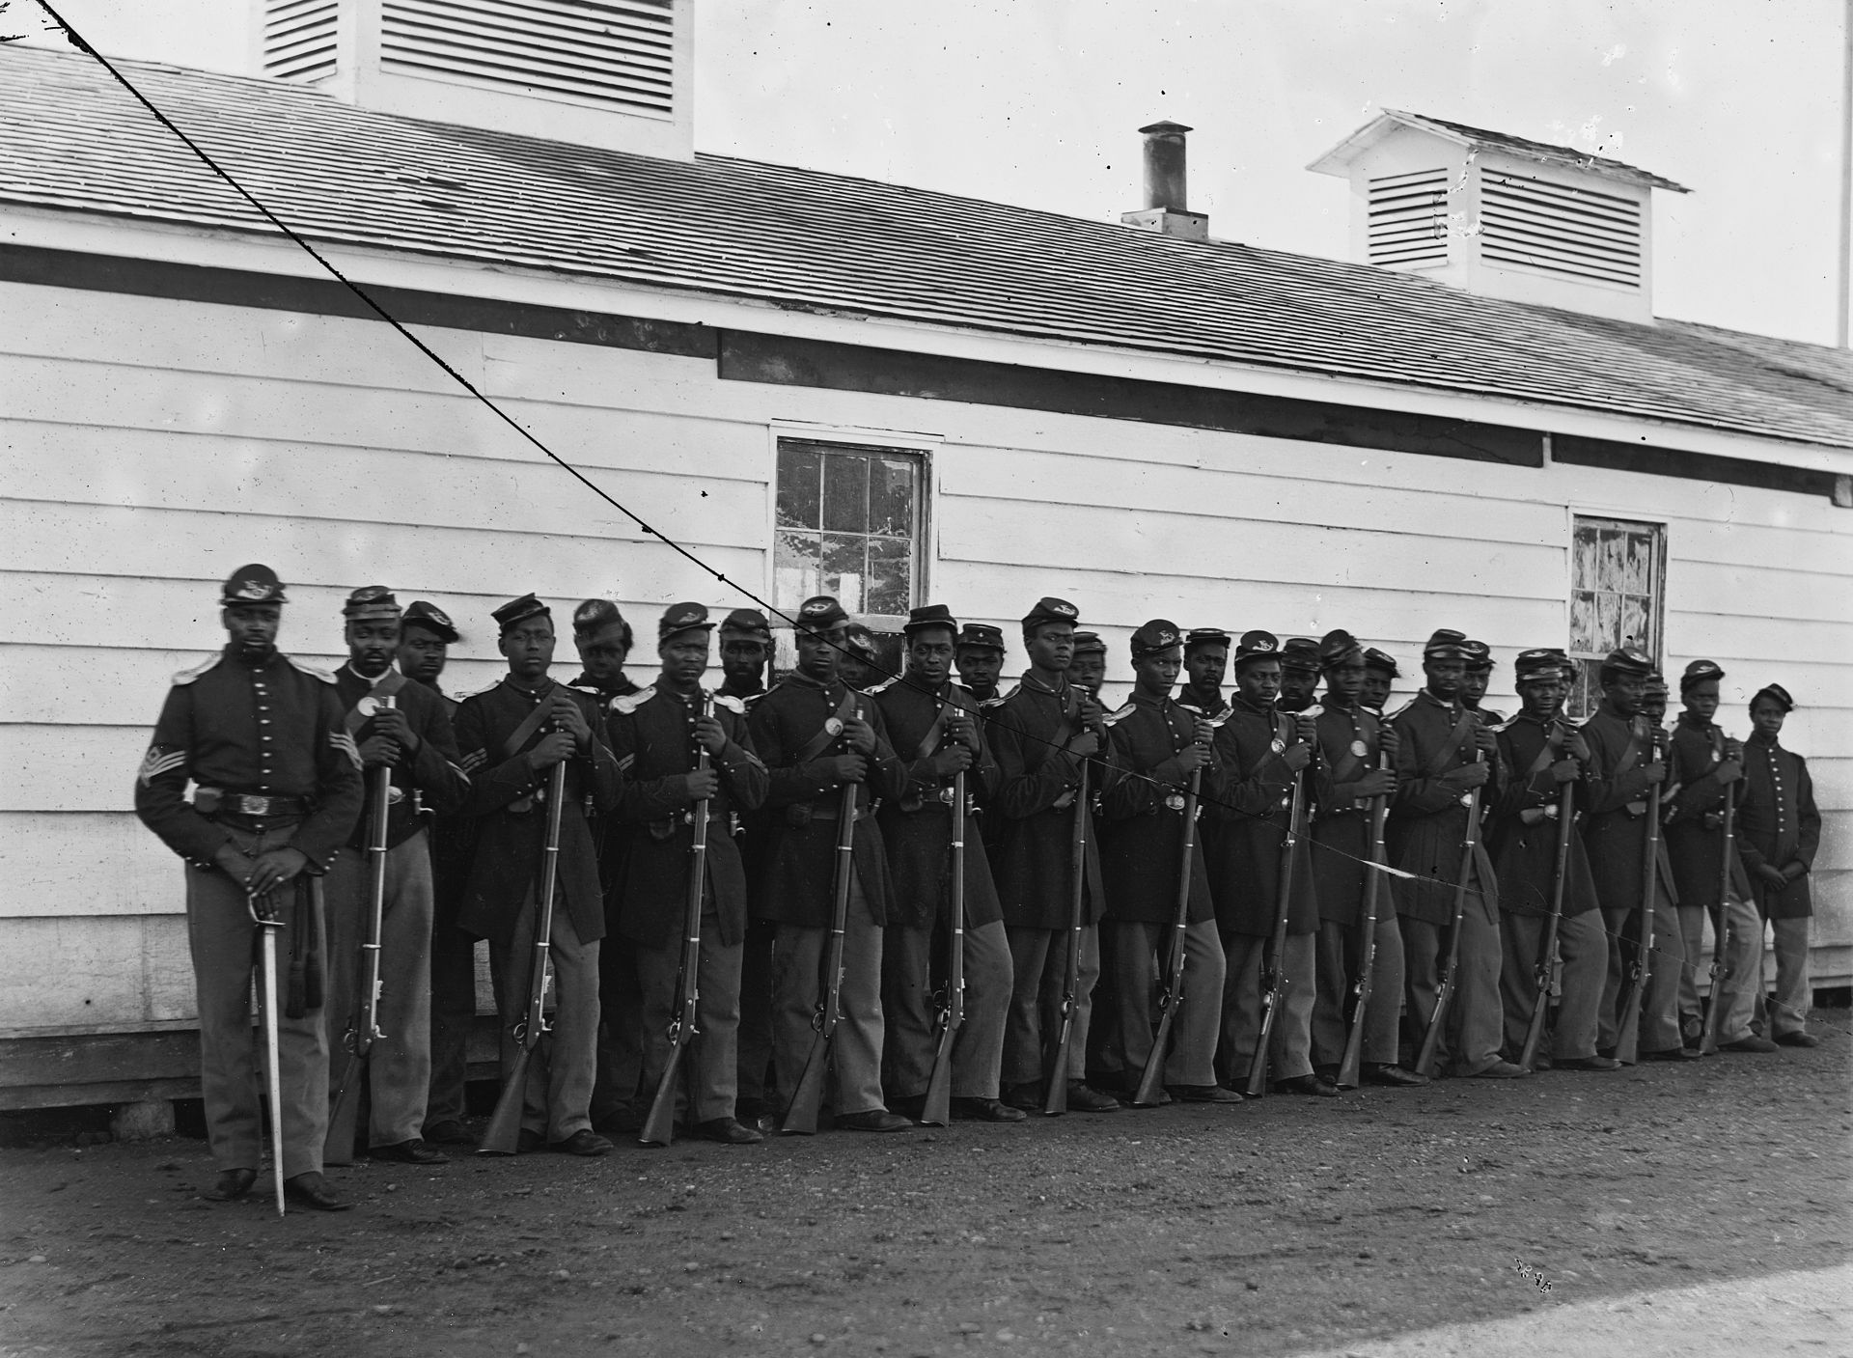
United States Colored Troops
In the Emancipation Proclamation Lincoln addressed the enlistment of African Americans in the United States armed forces. Approximately 180,000 men -- many who had formerly been enslaved -- volunteer to fight in the Union army.
This will greatly help the war effort and may be the difference between losing or winning the war.

Slide 24
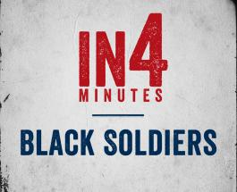
Black Soldiers in the Civil War
Activity
Watch the In4: Black Soldiers video.
Notes:
https://www.battlefields.org/learn/videos/black-soldiers-civil-war

Slide 25
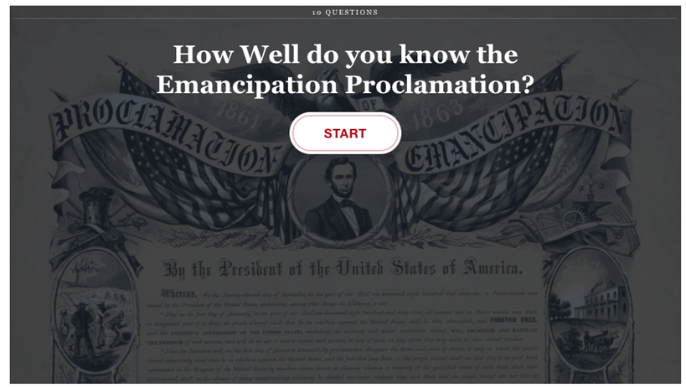
Quiz #1
Notes:
https://www.battlefields.org/learn/quizzes/how-well-do-you-know-emancipation-proclamation

Slide 26
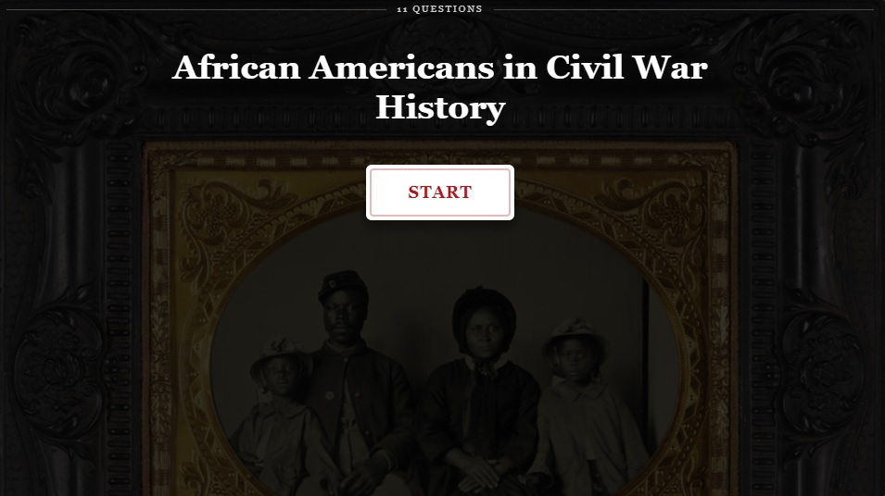
Quiz #2
Notes:
https://www.battlefields.org/learn/quizzes/african-americans-civil-war-history

